Slide 1
The Effect of Environment on Color Naming Schemes
Ameena Golding, Max McArthur, Vasilis Oikonomou

Slide 2
Introduction
Question: Do color naming schemes of different languages depend on the distribution of colors in the environment where the language was developed?
Null hypothesis: Distribution of colors in immediate environment is the same as distribution of colors in Munsell space partitioning.
→ Predictions

Slide 3
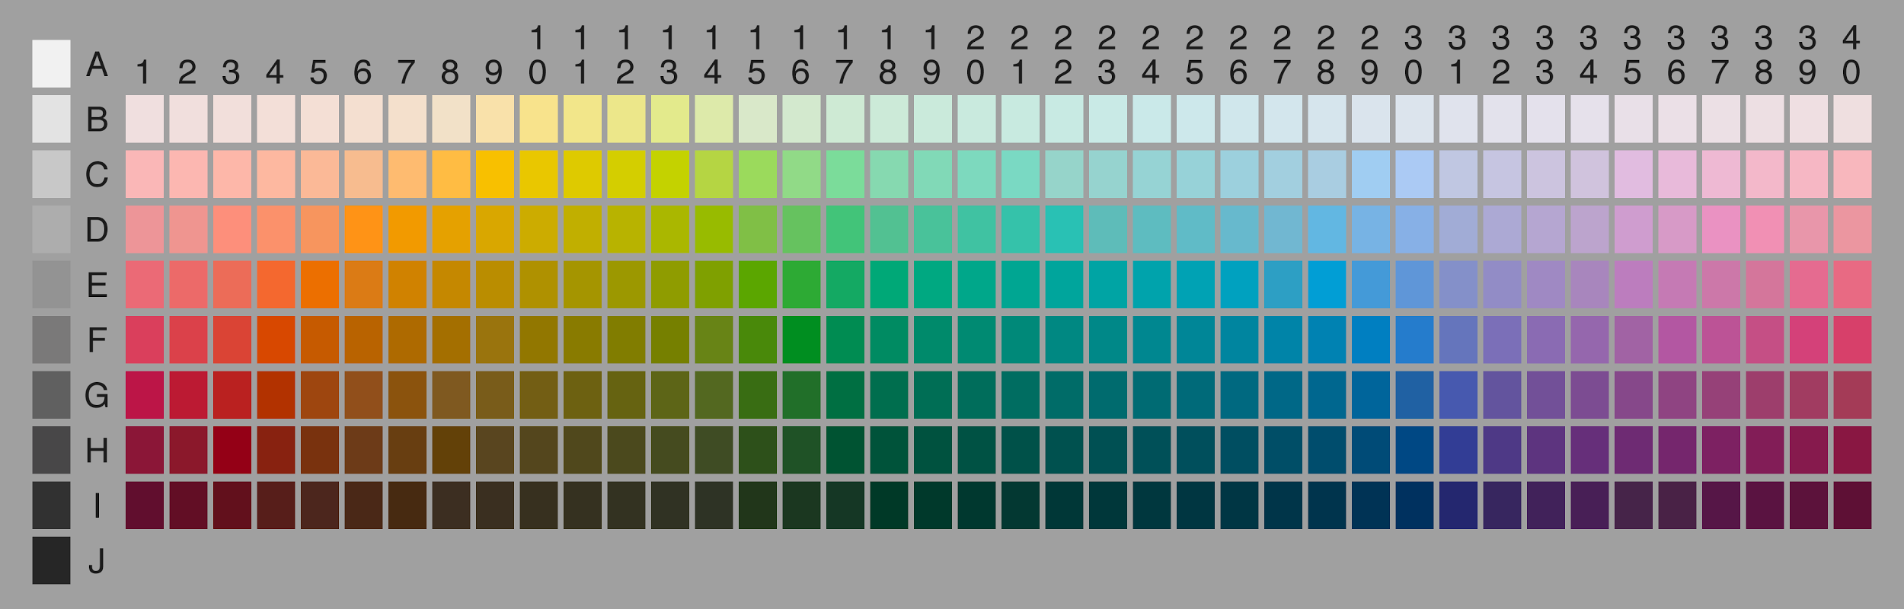
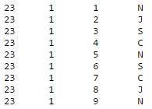
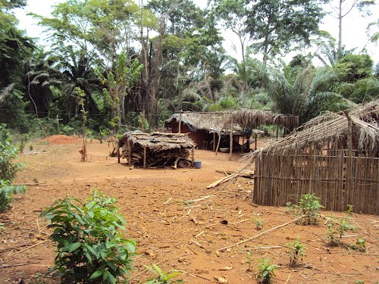
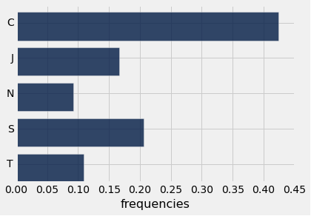
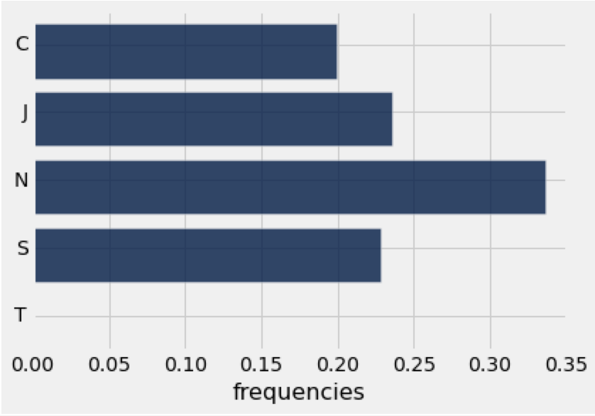
Data Analysis
Empirical Data Collection
Theoretical Data Collection
proportions
(term.txt)
TVD Analysis
proportions

Slide 4
Results - Main Findings
Observed results Predictions
p-value = 0
White-Black → sometimes overestimated
Red → underestimated as predicted
Interesting observation: Observed TVD ranged 0.2-0.3 for all 4 languages

Slide 5
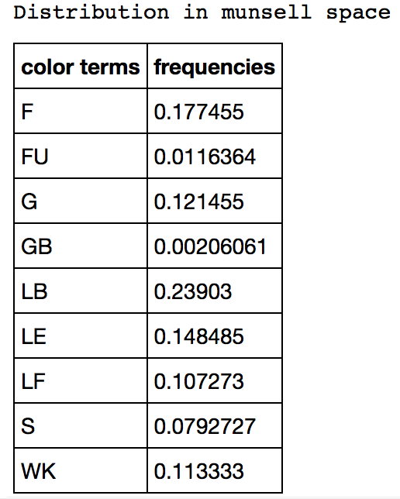
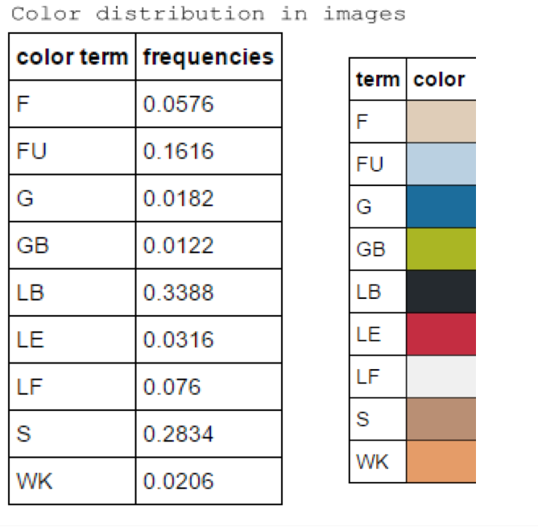




Example - Abidji/Ivory Coast
overestimated:
unusual

